Slide 1
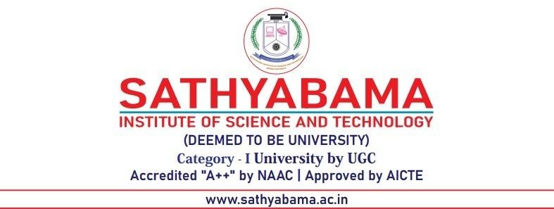
DEPARTMENT OF COMPUTER SCIENCE AND ENGINEERING
Online Movie Ticket Booking System
JAVA FULLSTACK PROJECT
PROJECT STUDENT
HARI LAVANYA 43611178
CSE AIML

Slide 2
PRESENTATION OUTLINE
Abstract
Existing system
Proposed system
Advantages
Disadvantages
Hardware requirements
Software requirements
Modules
Module description
Sample output(screenshot)
Conclusion

Slide 3
ABSTRACT
The Online Movie Ticket Booking System simplifies the process of purchasing movie tickets for users while enabling theaters to efficiently manage screenings. The system provides an interactive web platform where users can browse movies, view showtimes, select seats, and securely book tickets. It enhances user convenience, reduces manual effort, and supports multiple payment options, ensuring a smooth and secure transaction experience.

Slide 4
Existing System
In the existing manual ticket booking process, customers have to visit theaters physically to check show timings and availability. This method is time-consuming and often leads to long queues and frustration. The management of ticket sales, refunds, and seat allocation is handled manually, which can result in errors and confusion. Customers have limited access to real-time information and must rely on phone inquiries or in-person visits. There is also a lack of transparency regarding available seats and prices. Maintaining manual records makes it difficult to track sales performance and customer data. The absence of online payment facilities further adds to user inconvenience. Thus, the existing system fails to meet the growing digital needs of users and theater businesses.

Slide 5
Proposed System
The proposed system introduces a fully automated, web-based platform for online movie ticket booking. Users can browse movies, view available seats, and make instant payments securely through integrated payment gateways. The platform is accessible 24/7, eliminating the need to visit theaters physically. It provides a seamless interface with modern design and efficient backend architecture to ensure smooth transactions. Real-time updates on seat availability, pricing, and showtimes enhance user experience. Administrators can manage listings, update schedules, and monitor sales reports easily. The system also sends email or SMS notifications to users for confirmation and reminders. It ensures data security through encryption and secure authentication methods. Overall, it offers a reliable, efficient, and user-friendly experience for both users and theaters.

Slide 6
Advantages
Eliminates manual ticket booking and reduces queues.
Allows 24/7 booking access from any device.
Real-time updates on seat availability and prices.
Secure payment processing through trusted gateways.
Automated email and SMS confirmations for users.
Centralized data storage for easy record management.
Admin can easily add, update, or delete movie details.
User-friendly interface suitable for all age groups.
Reduces operational costs for theaters.
Provides transparency and convenience to users.

Slide 7
Disadvantages
Requires a stable internet connection to function properly.
In case of server downtime, booking services may be disrupted.
Security risks exist if the system is not regularly updated.
High initial setup and maintenance costs for hosting and database.
Users with limited digital literacy may face difficulty.
Dependence on third-party payment systems may cause delays.
System bugs or technical issues could affect performance.
Not suitable for theaters in remote areas with poor internet access.

Slide 8
Hardware Requirements
• Processor: Intel i3 or higher
• RAM: Minimum 4 GB
• Hard Disk: 250 GB or more
• Monitor: 15-inch LED display
• Input Devices: Keyboard, Mouse
• Internet Connectivity: Broadband connection

Slide 9
Software Requirements
• Frontend: HTML, CSS, JavaScript, React
• Backend: Node.js / PHP / Python
• Database: MySQL
• Operating System: Windows / Linux
• Payment Integration: PayPal, Stripe
• Email Service: SendGrid

Slide 10
Modules
1. User Registration & Login
2. Movie Listing & Management
3. Seat Selection & Booking
4. Payment Processing
5. Booking History
6. Messaging & Notifications
7. Review & Rating System

Slide 11
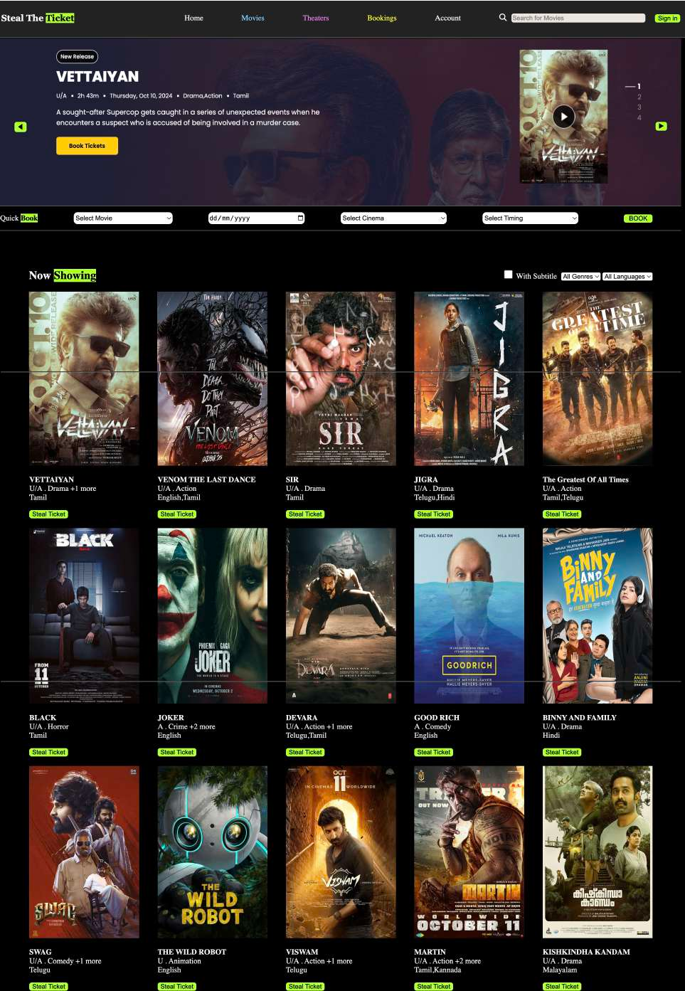

Slide 12
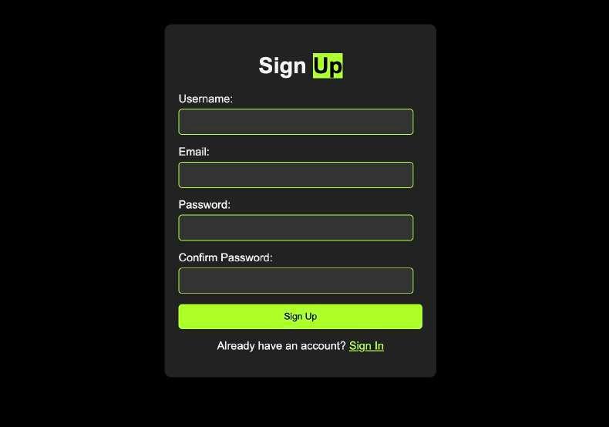
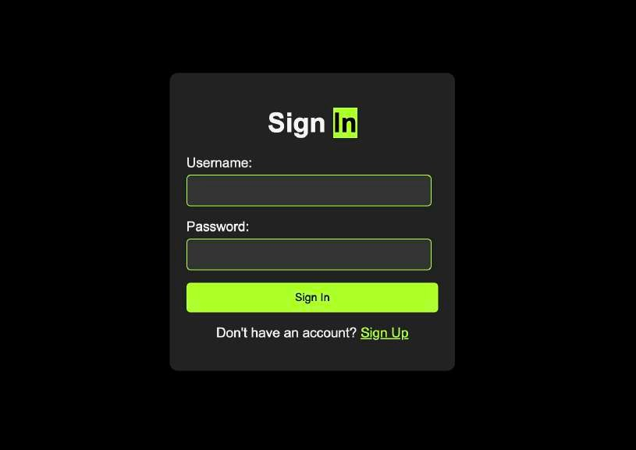
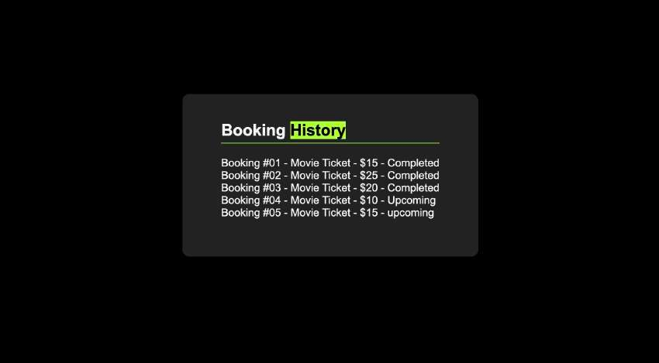

Slide 13
CONCLUSION
The Online Movie Ticket Booking System streamlines ticket reservation for both users and theaters. It reduces manual work, enhances convenience, and provides a secure, scalable, and user-friendly interface. With its robust architecture, the system ensures smooth performance and improved accessibility. Future enhancements may include AI-driven recommendations, mobile app integration, and multilingual support.

Slide 14


